Slide 1
Predict stock prices using Machine Learning
Ritu Choudhary

Slide 2
Steps taken:
Collecting the data
Preparing the data
Training the model
Evaluating the model
Reporting the model and making prediction

Slide 3
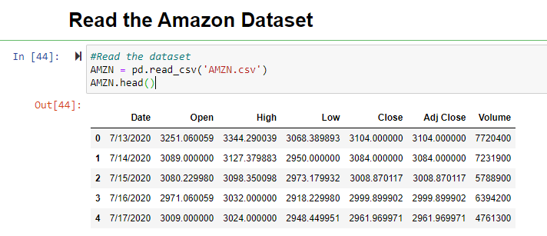
Collecting the data
I have worked on Amazon stock price during this project.
Downloaded data from yahoo finance and saved the file.
Read the dataset from downloaded csv file.

Slide 4
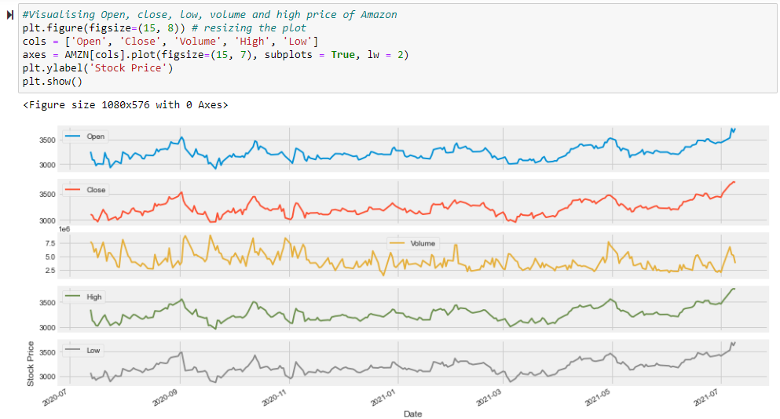
Visualize the dataset

Slide 5
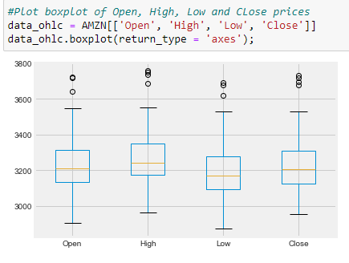
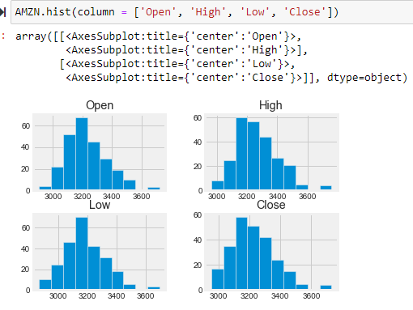
Visualize the dataset

Slide 6
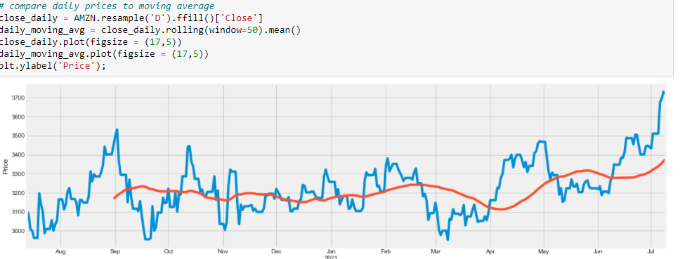
Rolling Mean
Rolling Mean (Moving Average) — to determine trend
Rolling mean/Moving Average (MA) smooths out price data by creating a constantly updated average price. This is useful to cut down “noise” in our price chart. Furthermore, this Moving Average could act as “Resistance” meaning from the downtrend and uptrend of stocks you could expect it will follow the trend and less likely to deviate outside its resistance point. (Tatan, 2019)

Slide 7
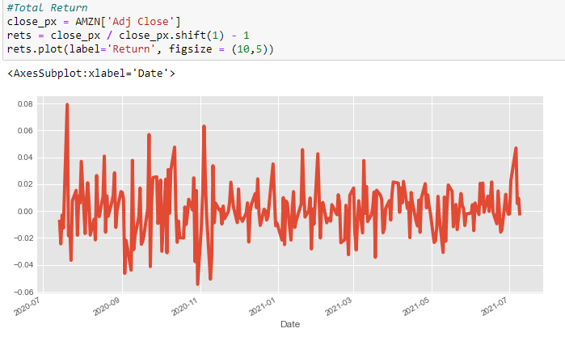

Return Deviation — to determine risk and return
Expected Return measures the mean, or expected value, of the probability distribution of investment returns. The expected return of a portfolio is calculated by multiplying the weight of each asset by its expected return and adding the values for each investment. Formula to calculate the return. (Tatan, 2019)

Slide 8
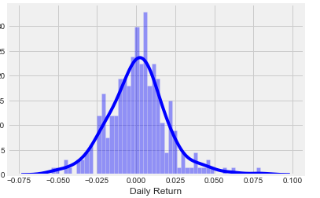
Daily price return of Amazon stock
The daily return column created by using the percentage change over the adjusted closing price
AMZN['Daily Return'] = AMZN['Adj Close'].pct_change()
AMZN.head()

Slide 9
Preparing the data
We will split the loaded dataset into two, 80% of which we will use to train, evaluate, and select among our models, and 20% that we will hold back as a validation dataset.
from sklearn.model_selection import train_test_split
df = AMZN[['Open', 'Close', 'Volume', 'High', 'Low’]]
x_train, x_test, y_train, y_test = train_test_split(df.Close ,df.Open,test_size = 0.2)
Scikit-learn is a Python machine learning library that is free to use. Scikit-learn provides a standard Python interface for a variety of supervised and unsupervised learning techniques. The library focuses on data modeling. It isn't focused on data loading, manipulation, or summarization.

Slide 10
Pre-processing & Cross Validation
Cleaned up and process the data using below steps before adding into the prediction models:
Dropped missing value
Separating the label here, we want to predict the Close price
Scale the X so that everyone can have the same distribution for linear regression
Finally We want to find Data Series of late X and early X (train) for model generation and evaluation
Separate label and identify it as y
Separation of training and testing of model by cross validation train test split

Slide 11
Training the model
I have test four different algorithms for my project
Linear Regression (LR)
Random Forest Regressor
SVR (Support Vector Regression)
KNN (K-Nearest Neighbors)
from sklearn.linear_model import LinearRegression, Ridge
from sklearn.neighbors import KNeighborsRegressor
from sklearn.ensemble import RandomForestRegressor
from sklearn.svm import SVR

Slide 12
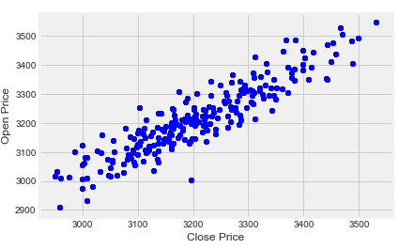
Open Price Vs Close Price

Slide 13
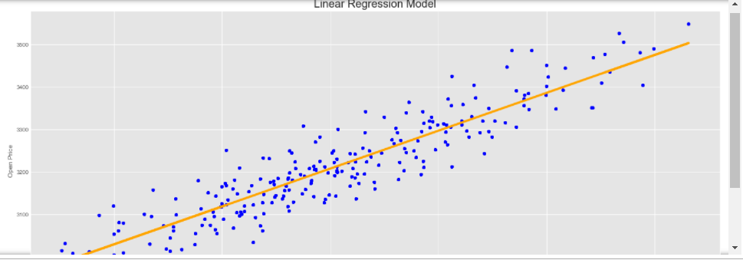
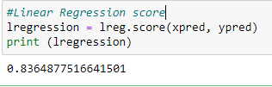
Linear Regression
Regression analysis is one of the most important fields in statistics and machine learning:
Linear Regression (LR): The term "linearity" in algebra refers to a linear relationship between two or more variables. If we draw this relationship in a two dimensional space (between two variables, in this case), we get a straight line.

Slide 14
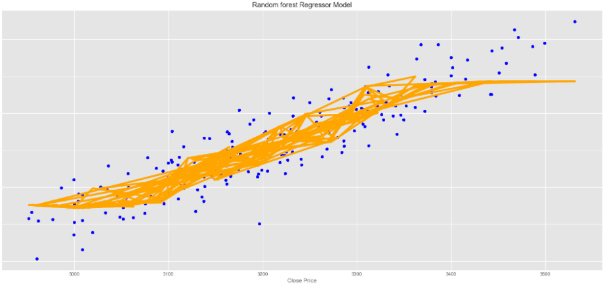
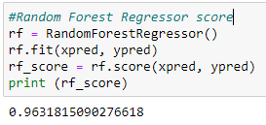
Random Forest Regressor
A random forest is an ensemble model that consists of many decision trees. Predictions are made by averaging the predictions of each decision tree. This makes random forests a strong modeling technique that’s much more powerful than a single decision tree.

Slide 15
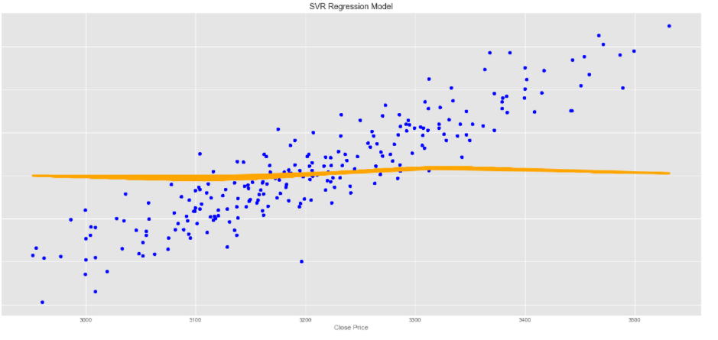
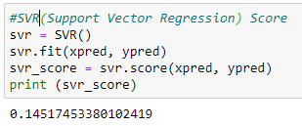
SVR (Support Vector Regression)
Support vector regression (SVR) is a statistical method that examines the linear relationship between two continuous variables.

Slide 16
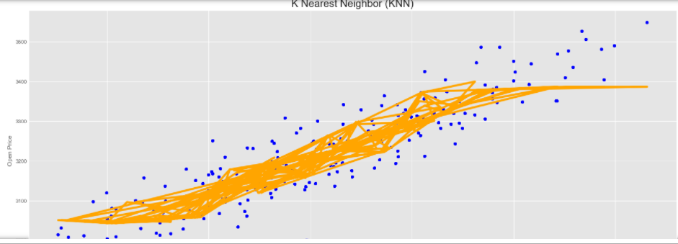
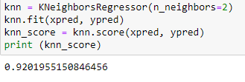
KNN (K-Nearest Neighbors)
K-nearest neighbors is a non-parametric method used for classification and regression. It is one of the most easy ML technique used. It is a lazy learning model, with local approximation. In KNN, we look for k neighbors and come up with the prediction.

Slide 17
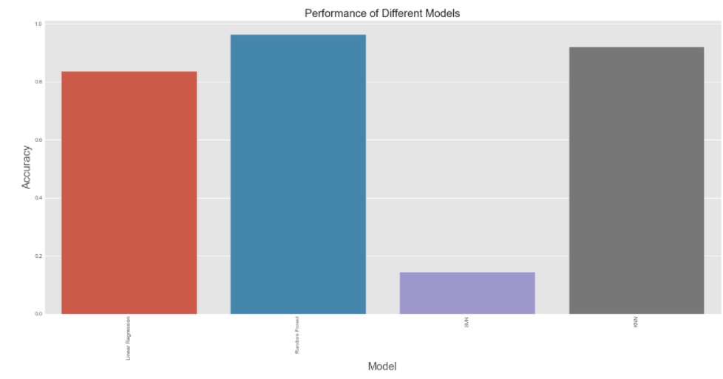
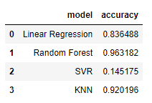
Compare performance of all the models
Barplot clearly shows the comparison between Linear Regression, Random Forest, SVR(Support Vector Regression) and KNN (K-Nearest Neighbors).

Slide 18
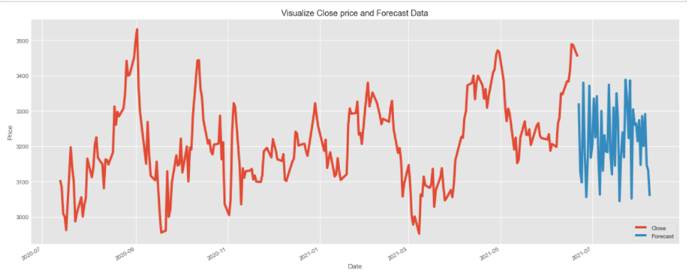
Visualize Close Price and Forecast the price

Slide 19

Conclusion
Based on analysis, it depicts that accuracy was higher for Random forest regression model. The predicting stocks is challenging due to data are complex nature. In this project, I used random forest regressor to create a prediction model, and the findings were precise. That proved to be a reliable indicator of stock movement direction in the future. Random Forest provided the best accuracy result in this model.

Slide 20
References
Tatan, V. (2019, May 26). Stocks Analysis with Pandas and Scikit-Learn. Retrieved from https://towardsdatascience.com/in-12-minutes-stocks-analysis-with-pandas-and-scikit-learn-a8d8a7b50ee7

